Slide 1

Lead Scoring Case Study

Slide 2



Problem introduction

Slide 3
introduction
X Education , an education company sells online courses to industry professionals.
Marketing is done through various channels.
People filling the enquiry form are considered as ‘lead’.

Slide 4

Problem Statement

Slide 5
Problem statement
Lead Conversion rate of X Education is poor.
Company wants to identify the lead with most potential.
We have to identify the set of ‘Hot Leads’ by data analysis and model building.
Target ball-park conversion rate by CEO is around 80%.

Slide 6

solution

Slide 7
Target solution
Identify hot leads with as much accuracy as possible.
Improve chance of achieving higher conversion ratio.
Obtain accuracy of around 80% or higher with the model.

Slide 8

Data analysis

Slide 9
process
Data Capturing
Data Cleaning (null value, duplicate value etc.)
EDA (numerical and categorical columns)
Data Analysis (outlier etc.)
Building Model
Model Improvement
Model Verification

Slide 10

Data visualization

Slide 11
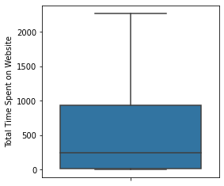
Univariate Analysis – Numerical Columns

Slide 12
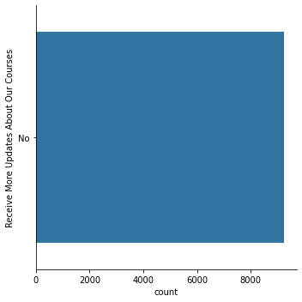
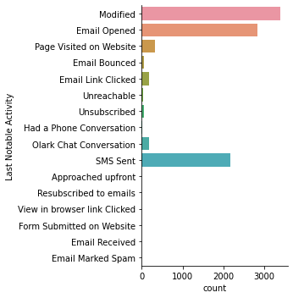
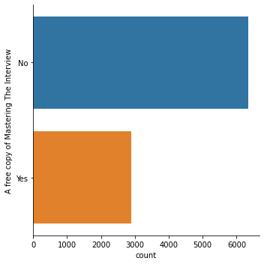
Univariate Analysis – Categorical Columns

Slide 13
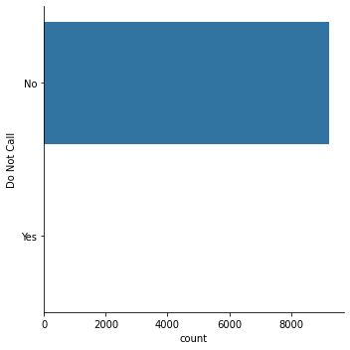

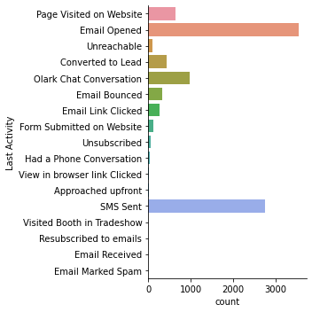
Univariate Analysis – Categorical Columns

Slide 14
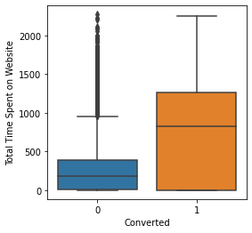
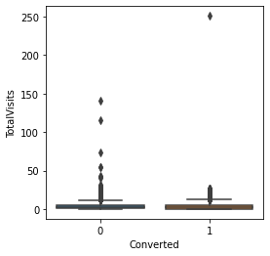
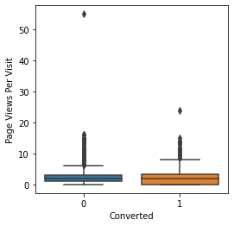
Bivariate Analysis – Numerical Columns

Slide 15
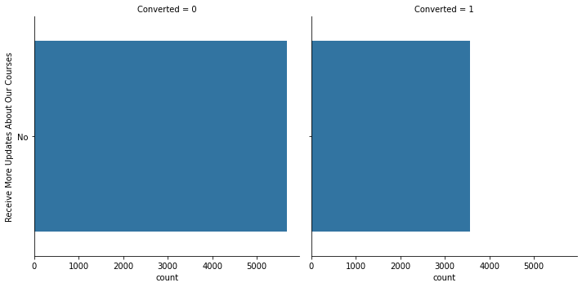
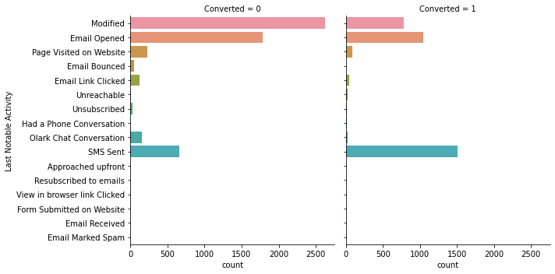
Bivariate Analysis – Categorical Columns

Slide 16
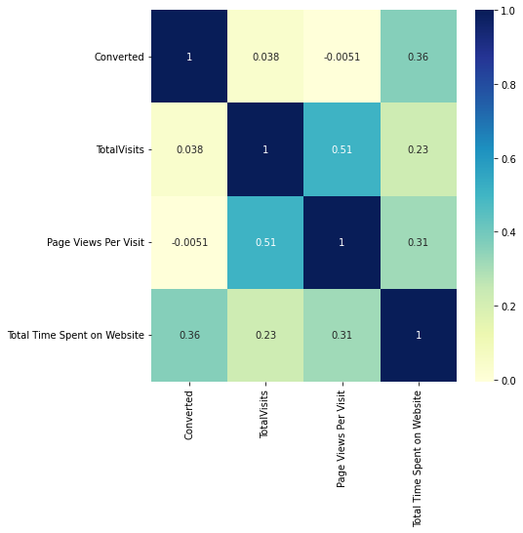
Multivariate Analysis

Slide 17
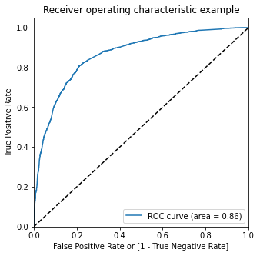
ROC Curve

Slide 18
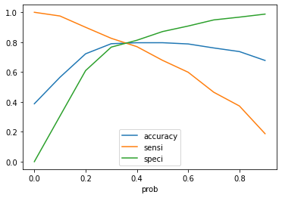
Cutoff

Slide 19

recommendations

Slide 20
Model details
Accuracy is around 80%
Precision is approx. 71% and recall is around 80%
Optimal cutoff seems to be around 0.36
ROC curve area is 0.86

Slide 21
conclusion
Top 3 variables for lead conversion are:
Total Time Spent on Website
Last Activity_SMS Sent
Last ActivityOlark Chat Conversation

Slide 22
conclusion
Top 3 areas for focus are:
Last Activity_SMS Sent (positively impacting)
Lead Source_Google (negatively impacting)
Lead Source_Email Opened (negatively impacting)

